Slide 1

Enhancing Customer Experience for:
Restaurant Mr. Chuan
FanBot
Team Members: Ivy Lou, Yusen Tang, Zhiming Zhang

Slide 2
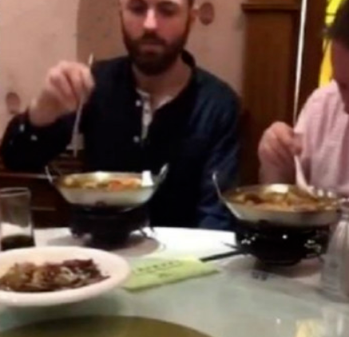
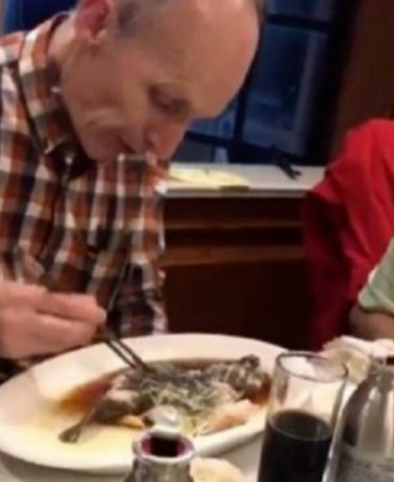
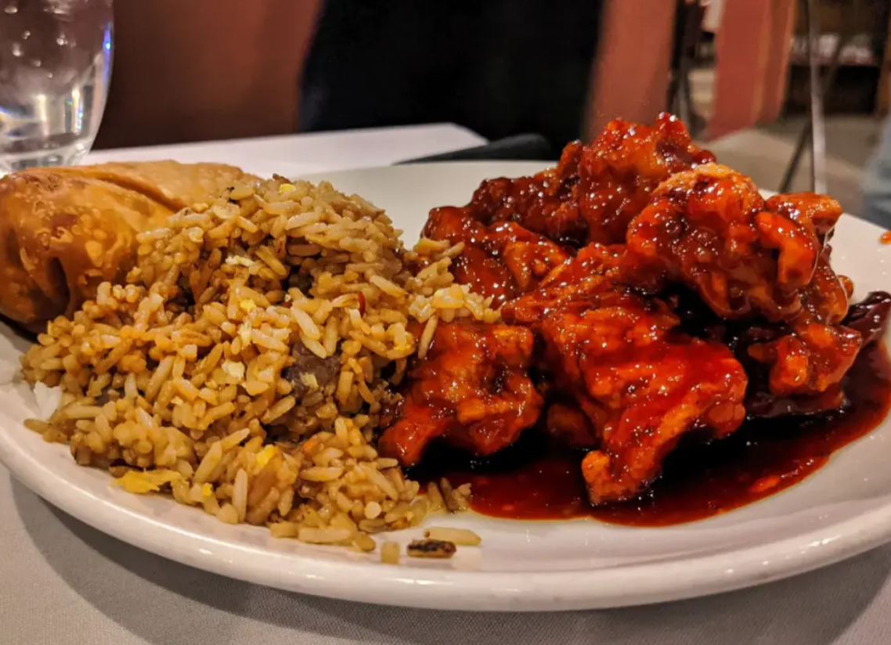
Cultural Estrangement

Slide 3
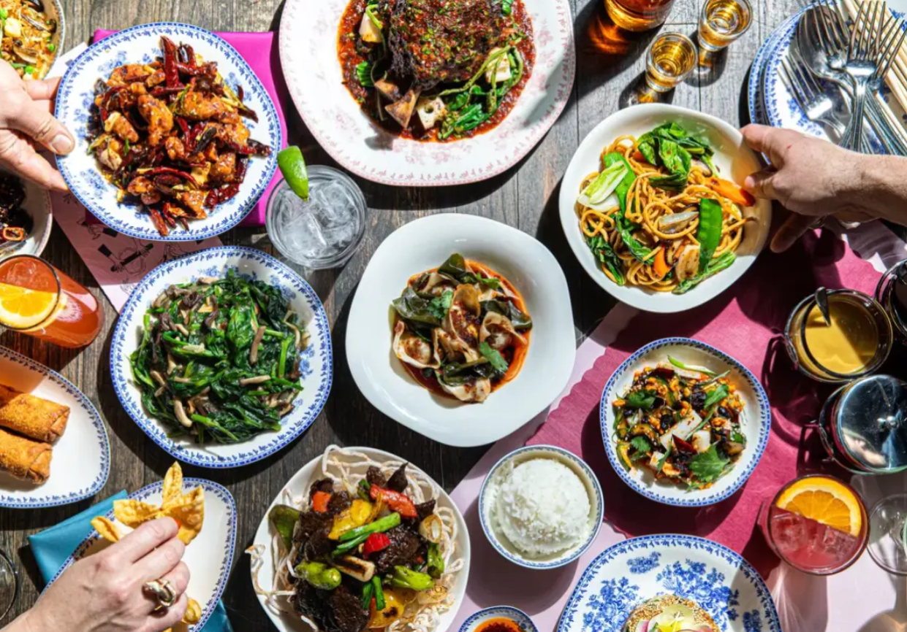
Impact on Catering industry
Language Barrier: For non-Chinese speakers, navigating Chinese menus and communicating dietary preferences or allergies can be challenging.
Ingredients and Presentation: Customers may be hesitant to try Chinese dishes due to unfamiliar ingredients, such as certain types of seafood, offal, or exotic meats.
Personal Taste Preferences: People might not enjoy the umami flavors, textures, or combinations that are common in Chinese dishes.
Difficulty in choosing : Unfamiliarity with the dishes combined with too many options makes ordering confusing

Slide 4
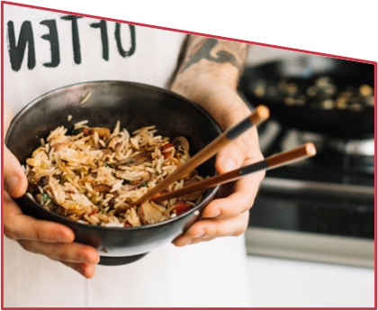
Technology Shortens the Distance Between People
What FanBot can do
Give customers more information about the dish before they even talk to the waiter
Suggesting dishes that might be to their liking based on customer groups
Provide customers with more information on discounts to promote more use.
Gathering user information and user comments for further research into subsequent customers taste preferences.
YUMMY!

Slide 5
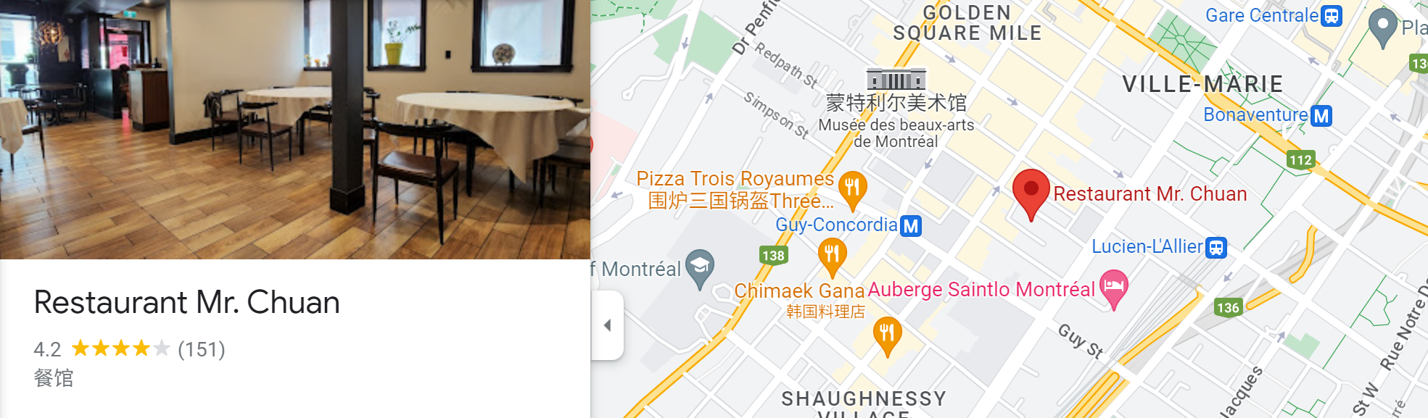
Restaurant Mr. Chuan
Highly rated Chinese restaurants serving typical and traditional Chinese food, popular among the Chinese community
Ten pages menu with more than 60 Chinese dishes.
Dining process: entering the restaurant, being seated, viewing the menu, communicating with the waiter, ordering, eating, checking out

Slide 6
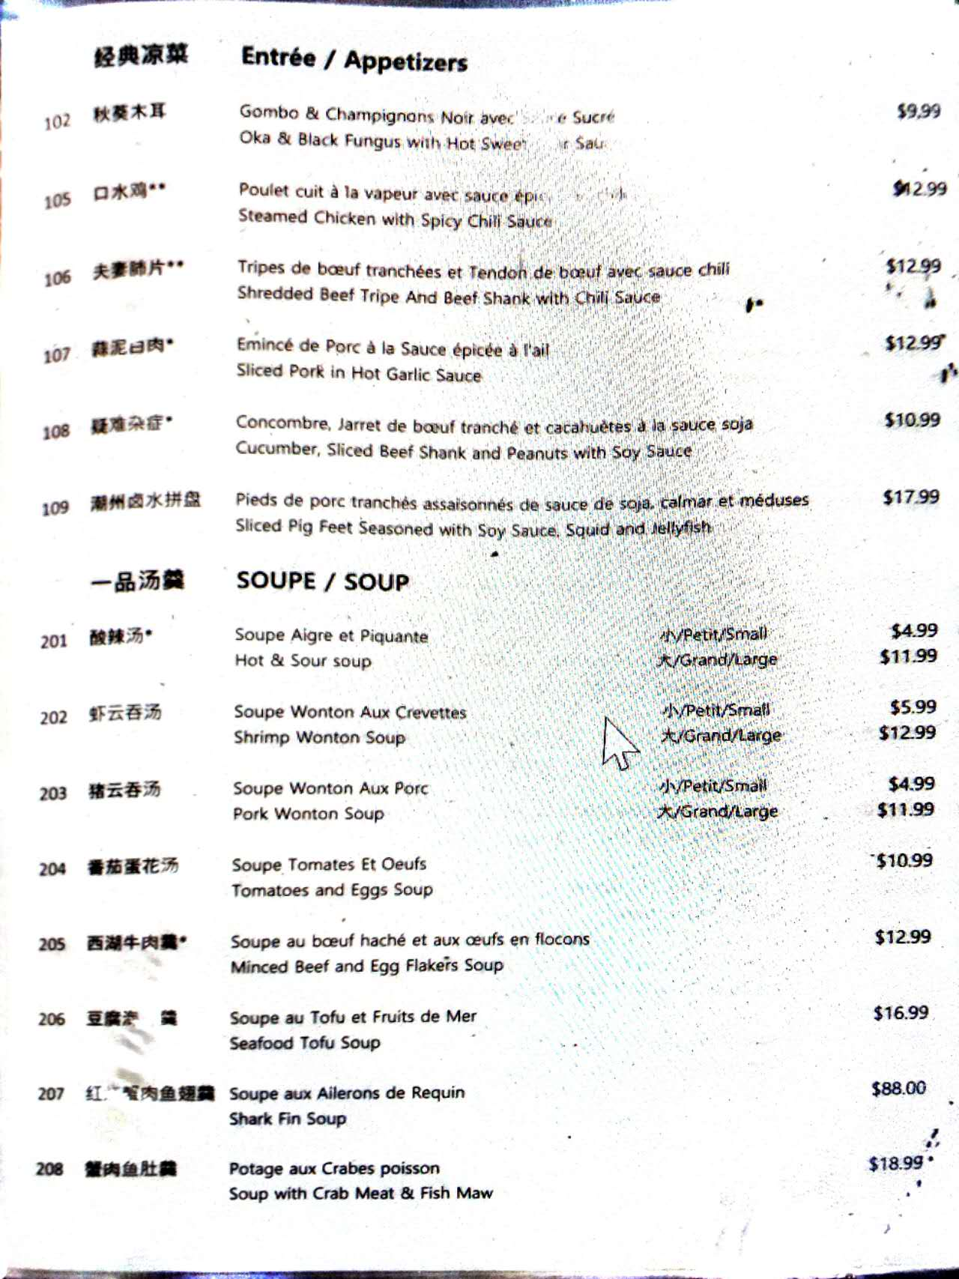
Issues
Limited information
Customers who don't know the dishes may not know what to order
Waiters are not always good at describing the flavours of the dishes
Difficulty in communicating when ordering can cause customers to turn away from the restaurant

Slide 7
Dish Recommendation
Promotion
Commenting
01
02
03
Food Ordering
Not Interested
04
05
Scenarios
To provide personalized dish recommendations to customers based on their preferences and dietary requirements.
To provide exclusive information about upcoming promotions and discounts for customers.
To allow customers provide feedback and comments regarding their dining or chatbot interaction experience.
To facilitates customers in placing orders for dishes from the restaurant menu.
To allow the customer exit the chatbot.

Slide 8
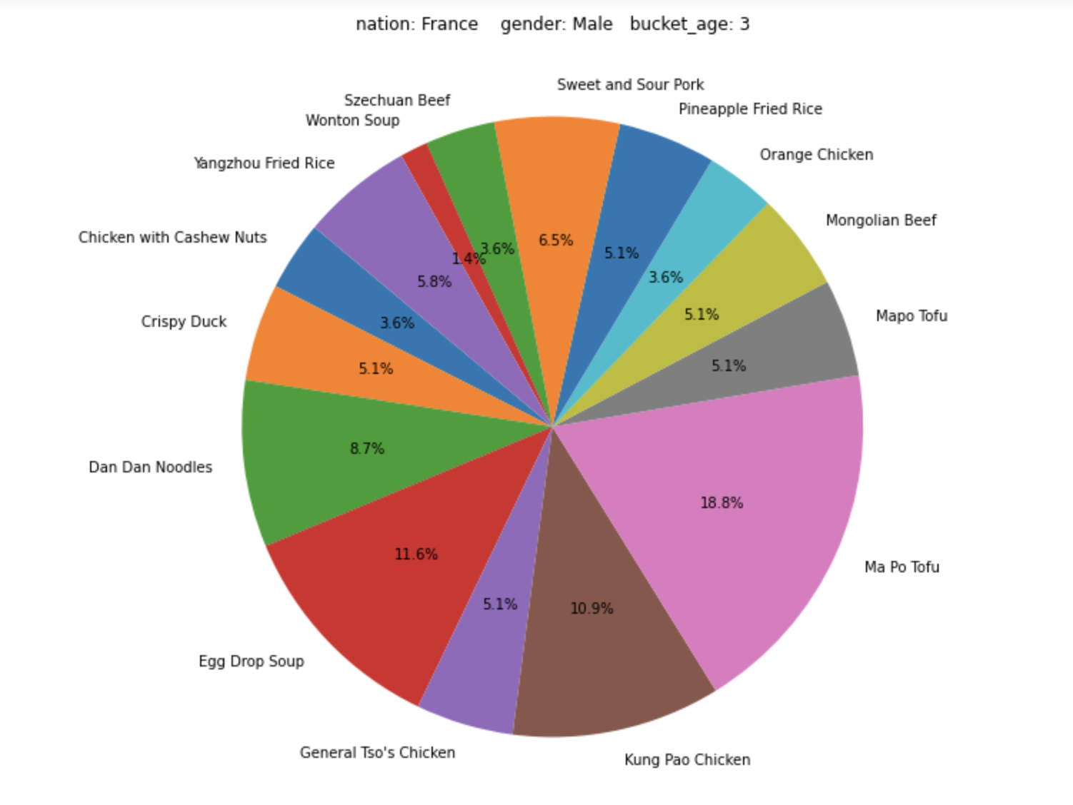
What Kind of Food is Loved by the French?
The graph displays the percentage of different dishes ordered by French people. From the previous consumer information and their ordering record we collected. We can make a pie chart by using （pandas.DataFrame.groupby） function and
(matplotlib.pyplot.pie) function.
The more data we collect, the graph will become more accurate, and we can give suggestions to consumer based on his or her nationality based on the data we analyzed.

Slide 9
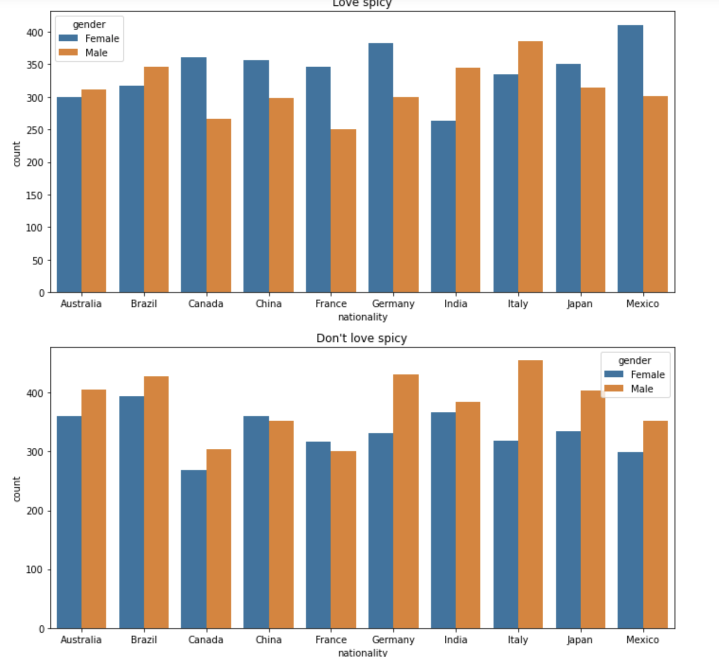
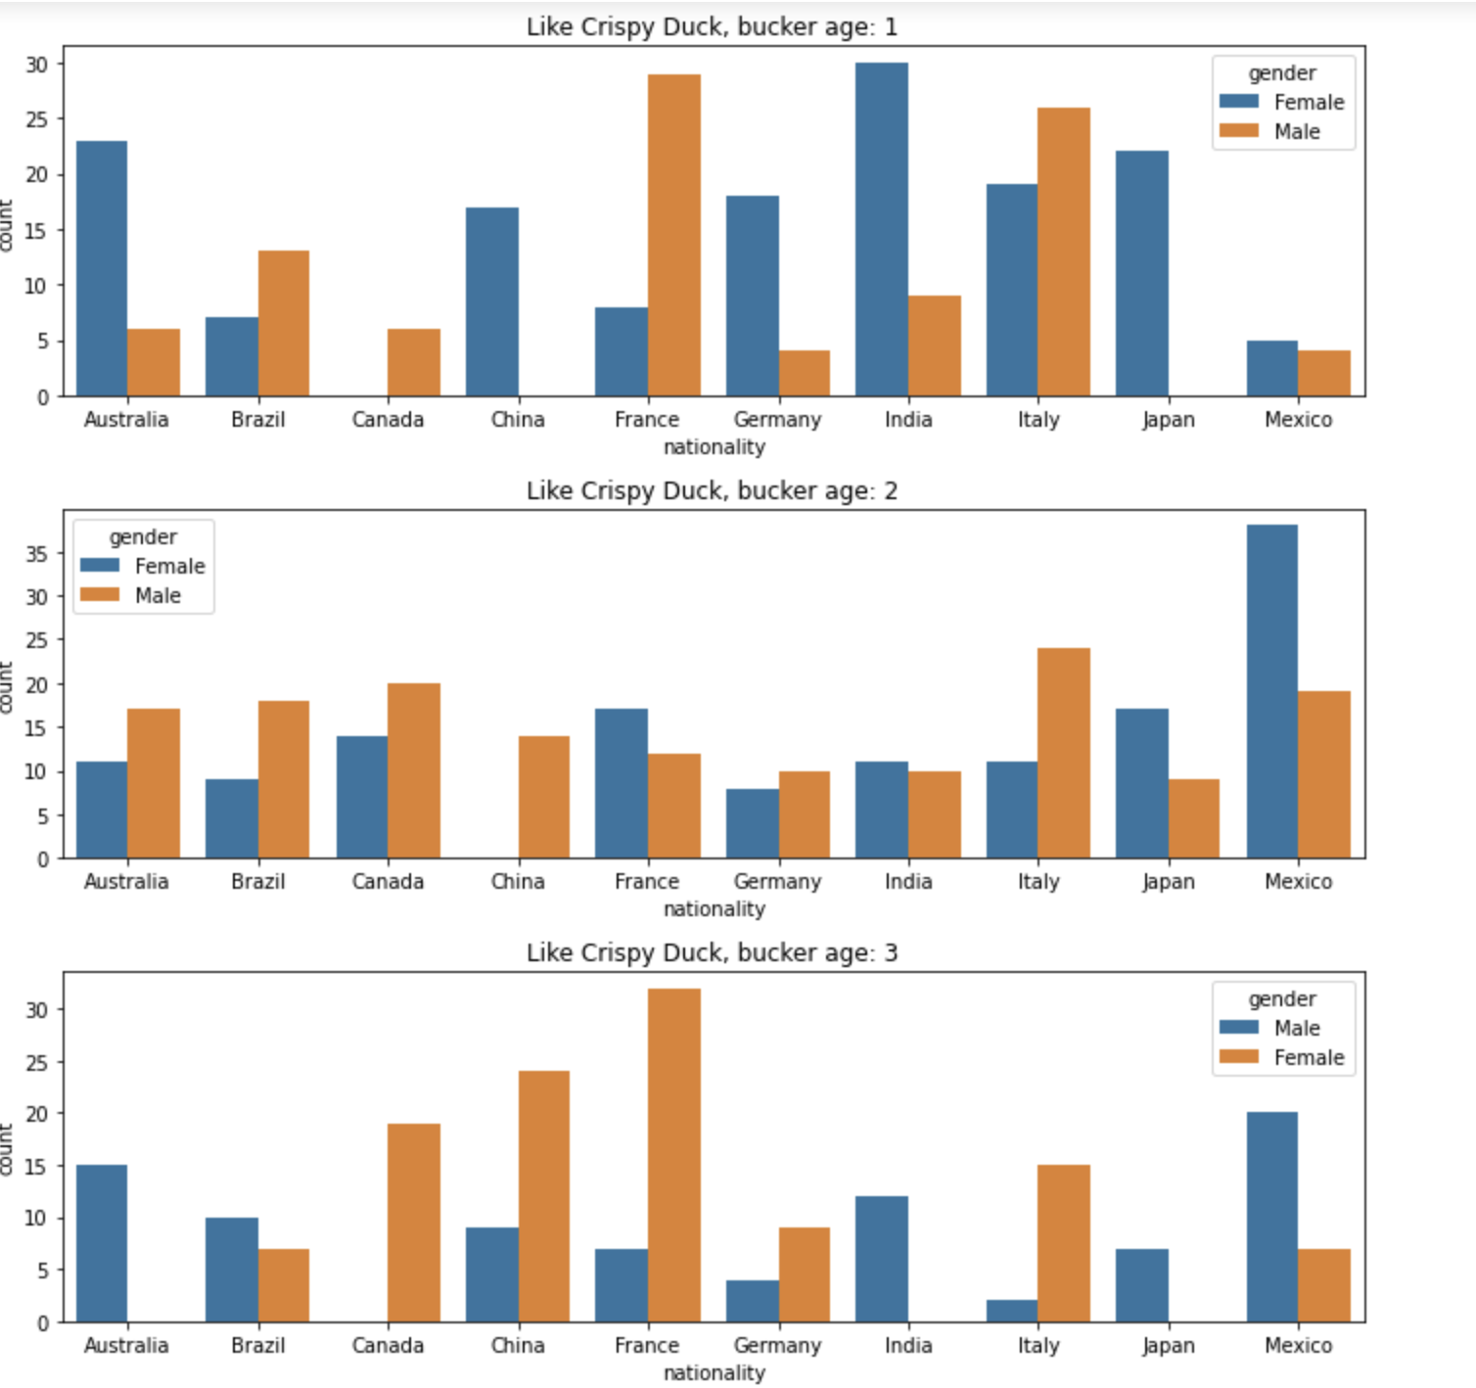
Who loves spicy food or crispy duck?
Form the data we collected; we can draw bar charts to show the percentage of people who loves spicy food or likes a specific dish such as crispy duck, by their nationality or age
We split age into 3 categories, group 1 is below 30 years old (youth), group 2 is 30~50 years old(middle age), and group 3 is beyond 50 years old.

Slide 10
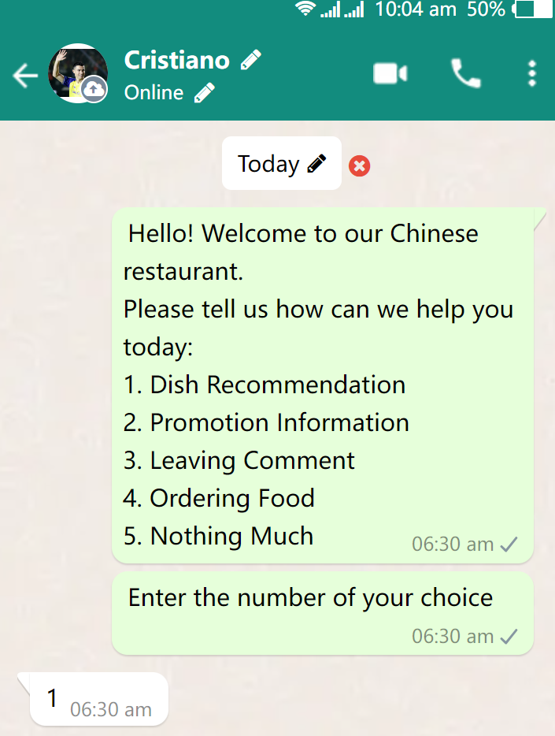
Dish Recommendation
chatbot_scenario()
Recommendation_scenario()

Slide 11
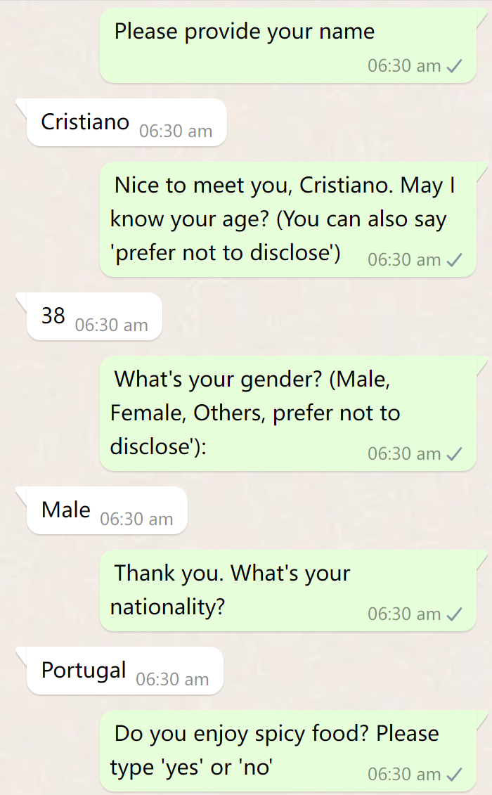
Dish Recommendation
name = input("Please provide your name: ")
Age = ask_age(name)
gender = ask_gender()
nationality = ask_nationality()
love_spicy = spicy_preference()
Create customer_info[name]
Transfer customer_info[name] into ['name','gender|Nationality|Age|spicy' ]

Slide 12
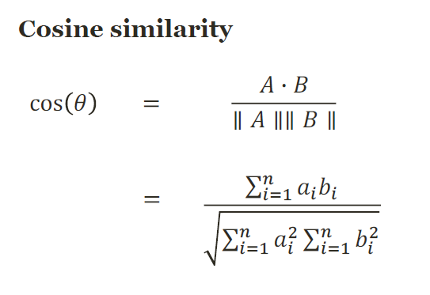
Dish Recommendation
Dish | Age | Gender | Nationality
Crispy Duck | 2 | Female | Switzerland
Ma Po Tofu | 2 | Male | Brazil
Name | Age | Gender | Nationality | Spicy like
Cristiano | 38 | Male | Portugal | No
Cal_similarity(df_customer)

Slide 13
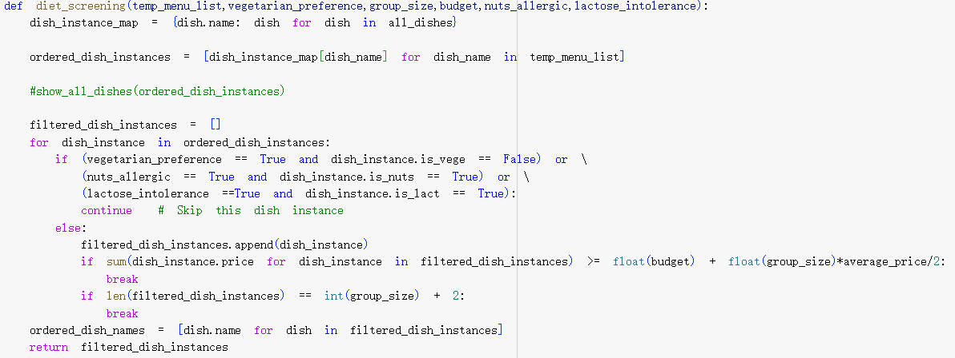
Dish Recommendation
def diet_screening()
We input a dish list with ascending order of similarity value
We ask more question related to dietary restriction as input parameter

Slide 14
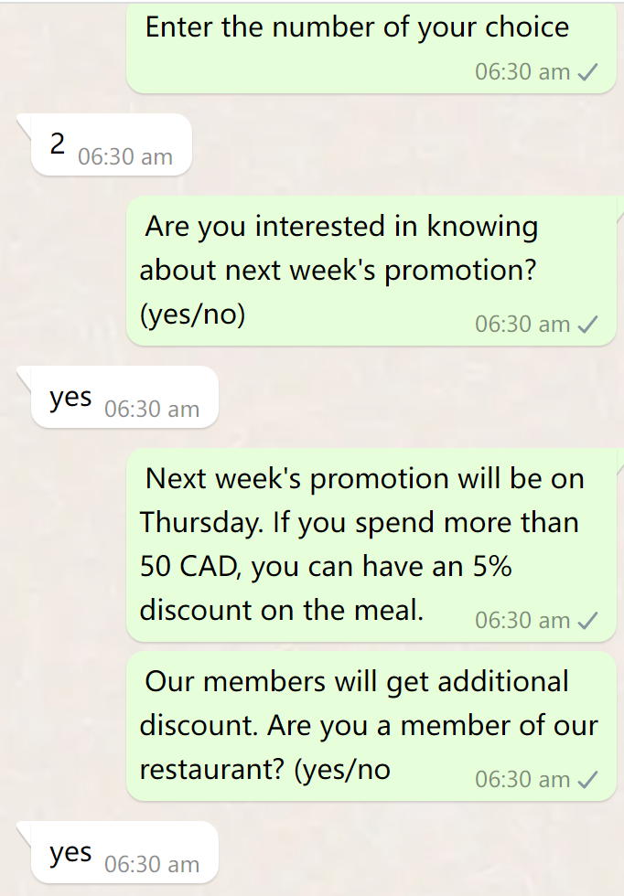
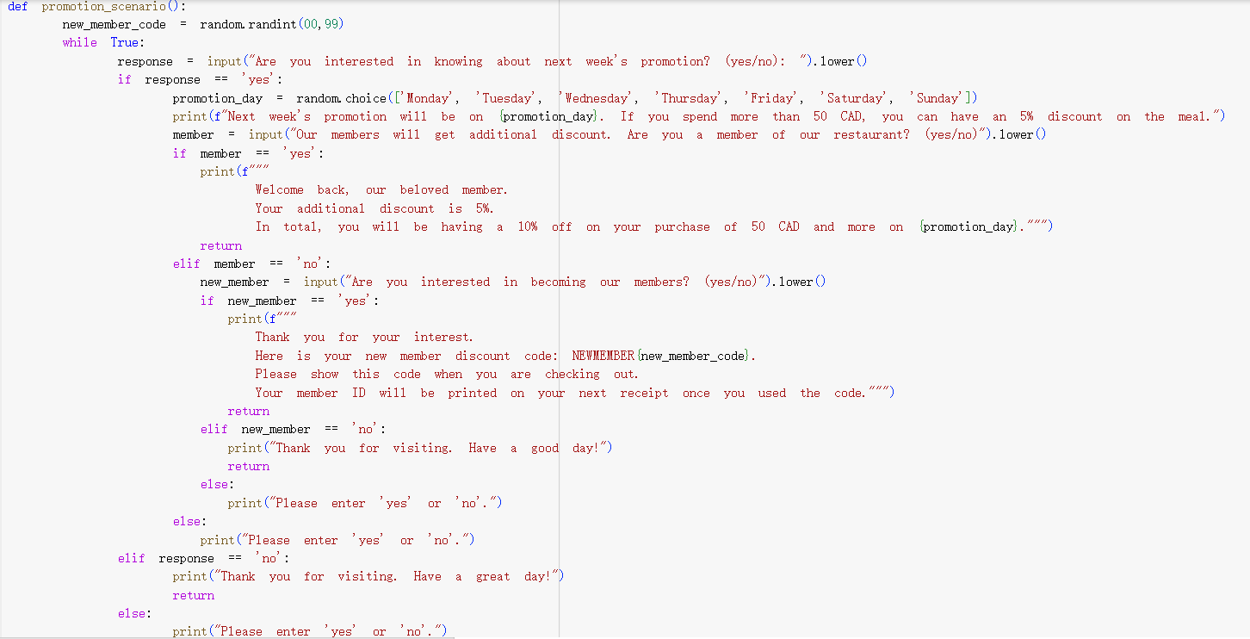
Promotion
Promotion_scenario()

Slide 15
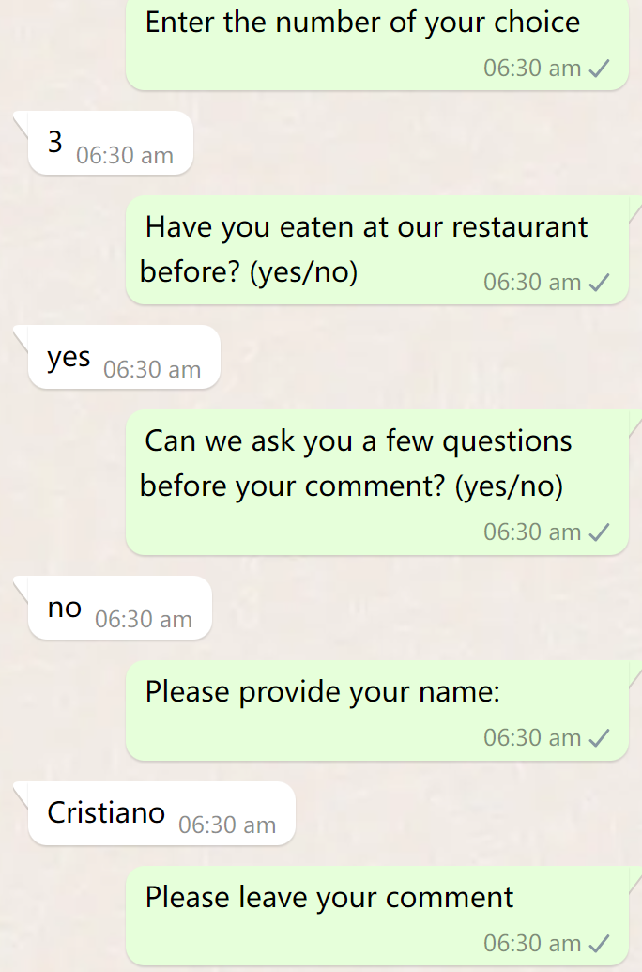
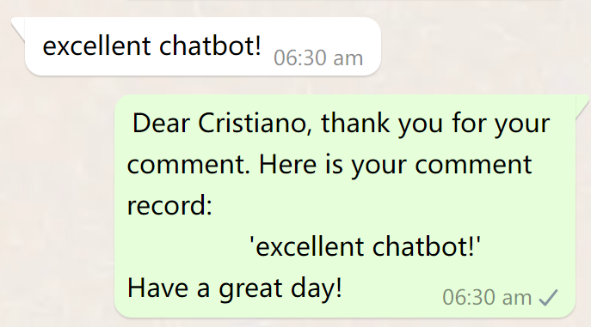
Leaving Comment
Comment_scenario()
We collect information from customers, asking their age, gender, nationality, etc, and write into excel
If the customer doesn't want to answer, then we only collect the comment

Slide 16
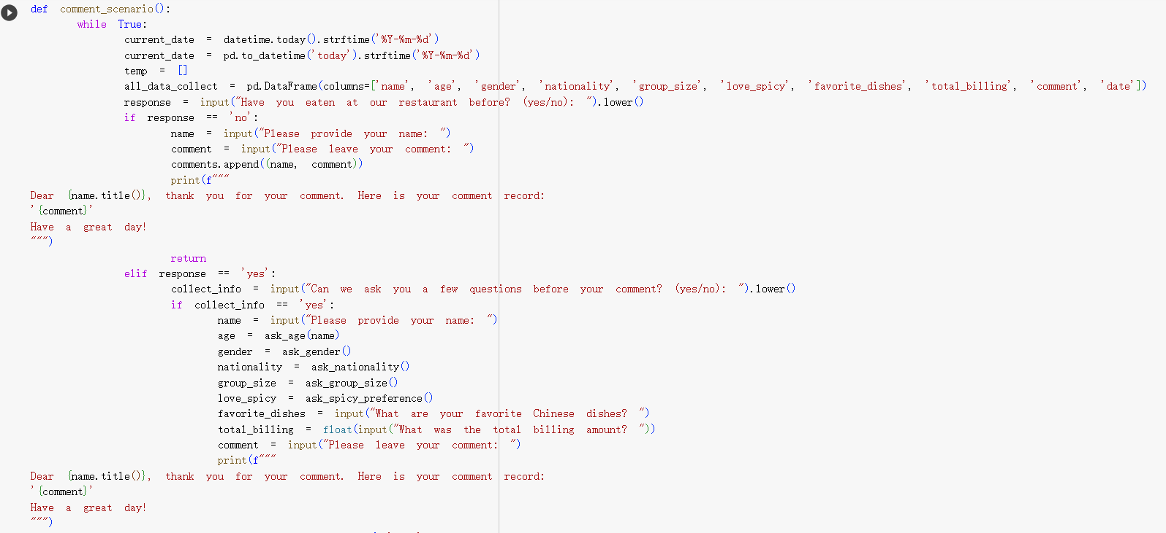
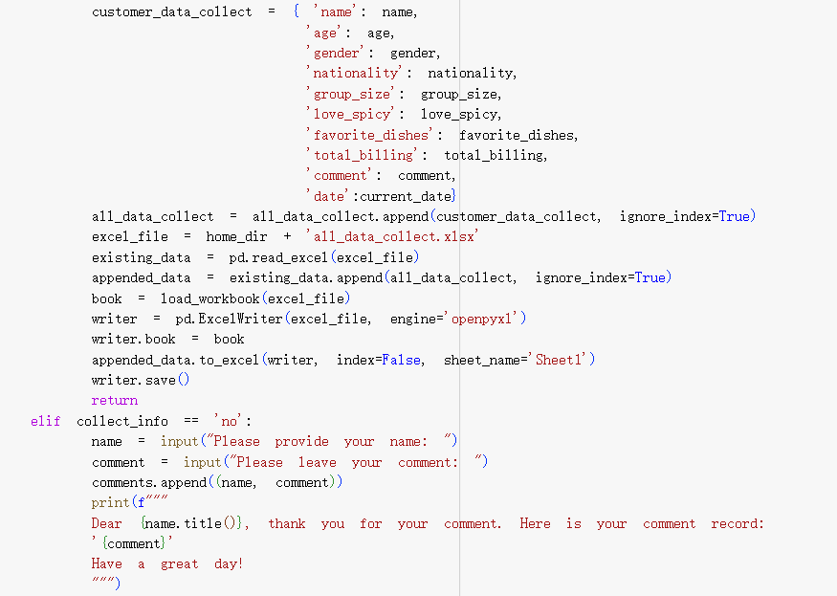
Leaving Comment

Slide 17
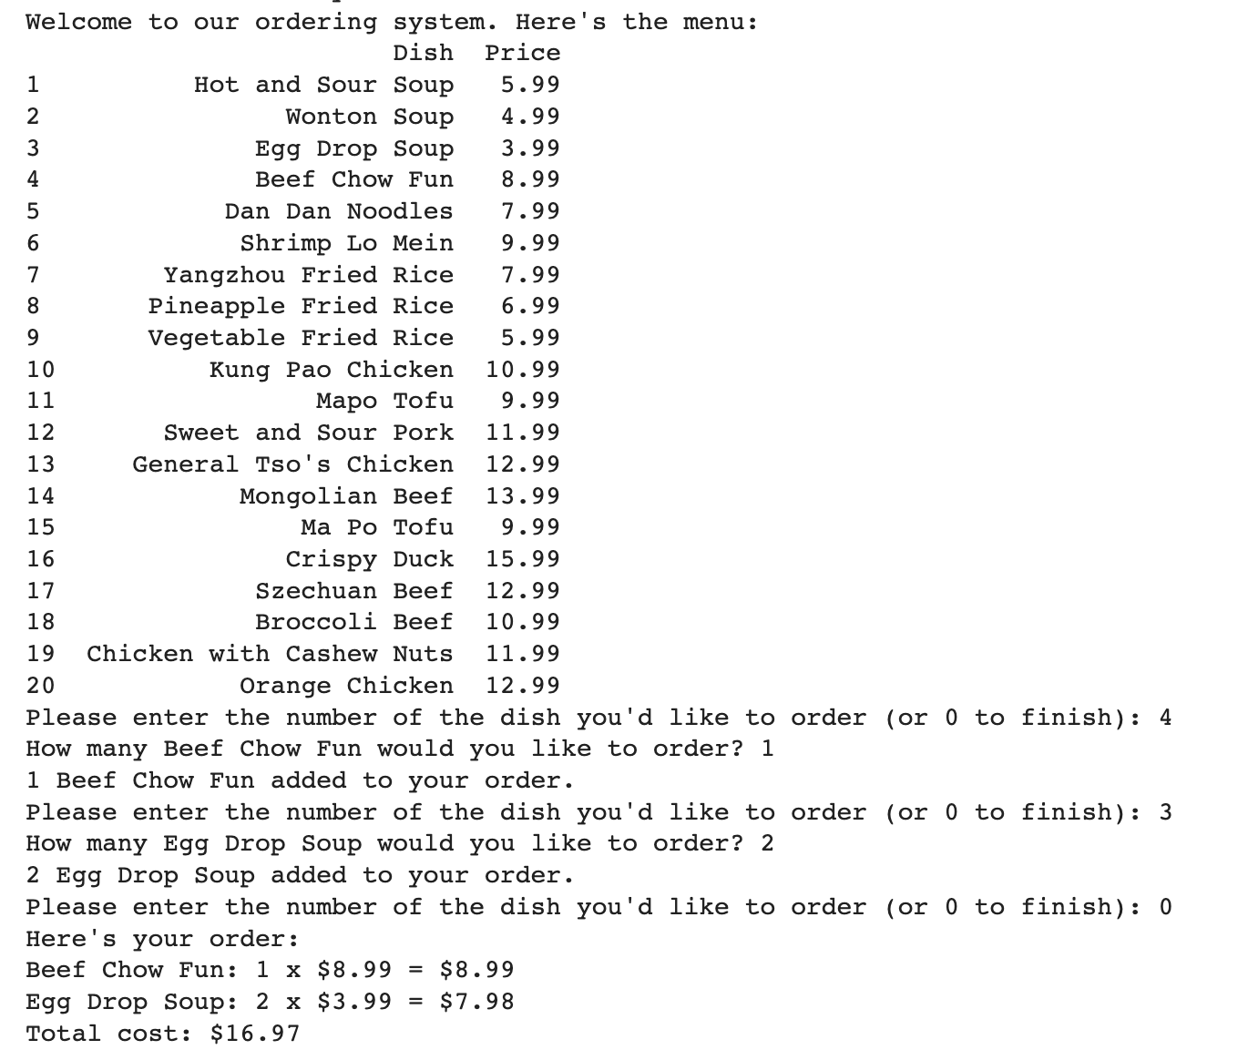
Order
Show menu
Order food and quantity
Calculate total price
Show order detail

Slide 18





Python Libraries and API
Write the collected customer data into excel
Data preprocessing
Dataframe Processing
Similarity Calculation
Calculation
Data visualization

Slide 19
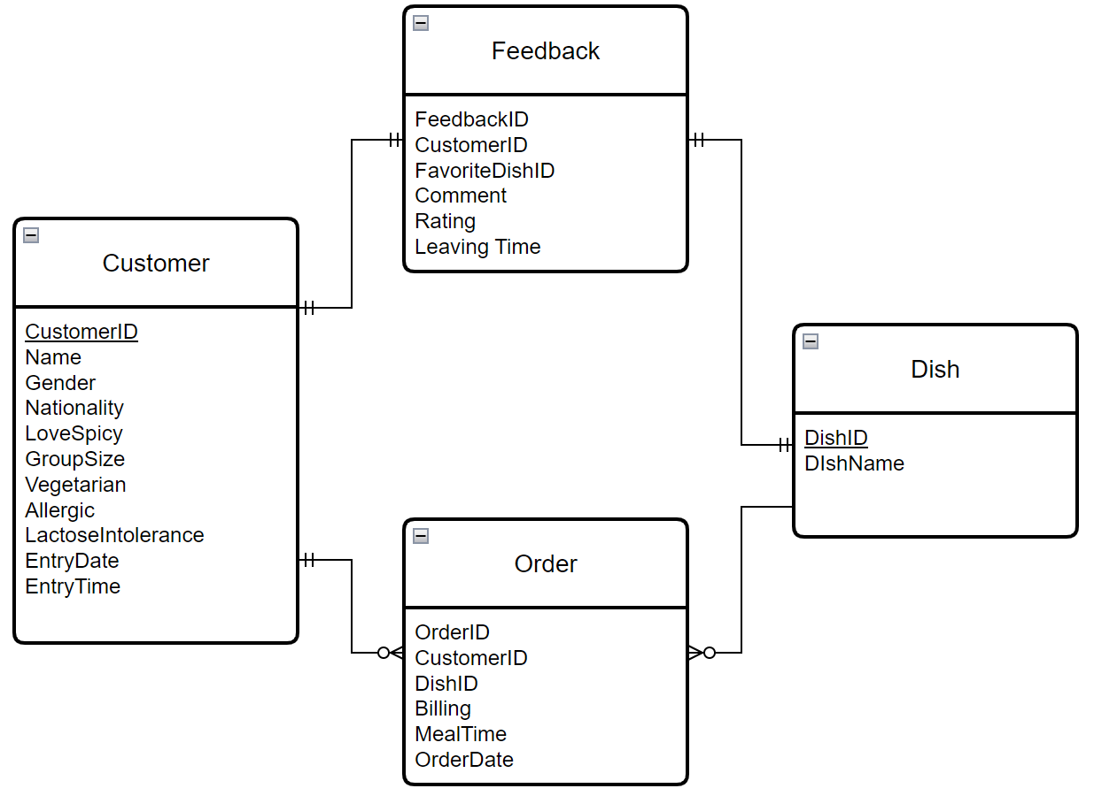
Looking Forward
Efficient Order Management
Insightful Analytics
Improved Customer Service
Customer Personalization and Loyalty

Slide 20
Thank You
It’s time for Q&A!

Slide 21
Appendix – Shift Gear
In the project proposal, our aim was to develop a chatbot for the restaurant Foiegwa. However, upon receiving feedback that highlighted the limitations of available data for comprehensive analysis, we pivot our focus towards making a chatbot service designed specifically for Chinese restaurants. To this end, we started with restaurant Mr. Chuan.
With this shift in direction, we ventured into creating new scenarios that diverged from our initial plans:
Promotion Scenario: Our intention here is to leverage exclusive promotional information as a means to enhance user engagement with the chatbot.
Commenting Scenario: Our goal is to facilitate the collection of user feedback, which can then be channeled to restaurant owners. This feedback loop not only allows restaurant proprietors to receive valuable insights but also contributes to the enhancement of our database and recommendation model through continuous improvement.

Slide 22
Appendix – New Library Used
Panads: read data from csv file, and analyze data by grouping, merging, reshaping, and selecting data. We can give recommendations to consumer based on the analyze result.
Matplotilb and seaborn: visualize data to bars and charts so we can have better understanding on different consumers' preferences.
Sklearn: tokenize the dataframe and using cosine similarity algorithm to calculate the similarity between dishes and customer preferences.
XlsxWriter: write the collected customer data into the excel file.
To further improve data analysis in the future, we can use scipy or scikit-learn to understand the distribution and characteristics of the data.

Slide 23
Reference
https://openpyxl.readthedocs.io/en/stable/formatting.html
https://www.classcentral.com/course/scikit-learn-for-machine-learning-classification--116616
https://www.python.org/

